Slide 1

CHAPTER 2
THE LOGIC OF
COMPOUND STATEMENTS
Copyright © Cengage Learning. All rights reserved.

Slide 2
SECTION 2.4
Application: Digital Logic Circuits
Copyright © Cengage Learning. All rights reserved.

Slide 3
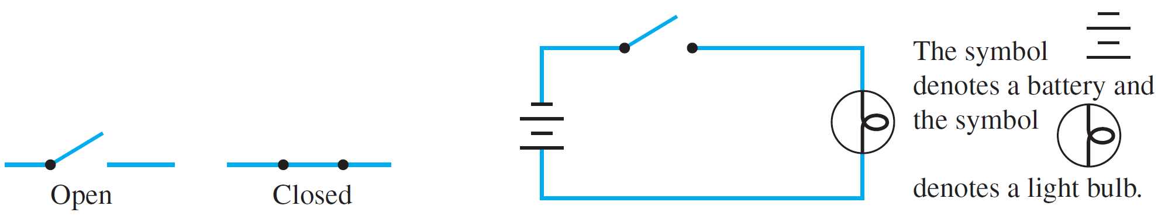
Application: Digital Logic Circuits
The drawing in Figure 2.4.1(a) shows the appearance of
the two positions of a simple switch. When the switch is
closed, current can flow from one terminal to the other;
when it is open, current cannot flow.
Imagine that such a switch is part of the circuit shown in
figure 2.4.1(b). The light bulb turns on if, and only if, current
flows through it. And this happens if, and only if, the switch
is closed.
(a)
(b)
Figure 2.4.1

Slide 4
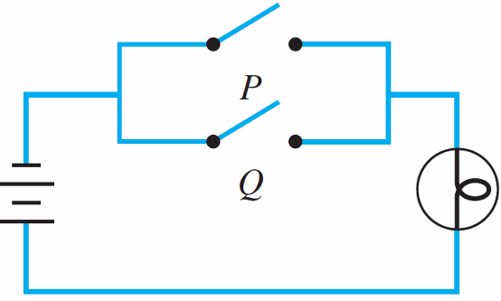
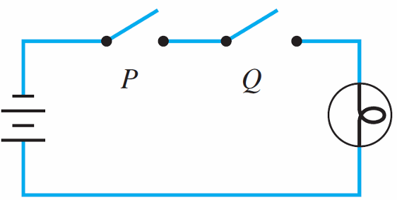
Application: Digital Logic Circuits
Now consider the more complicated circuits of Figures 2.4.2(a) and 2.4.2(b).
In the circuit of Figure 2.4.2(a) current flows and the light
bulb turns on if, and only if, both switches P and Q are
closed. The switches in this circuit are said to be in series.
(a) Switches “in series”
(b) Switches “in parallel”
Figure 2.4.2

Slide 5
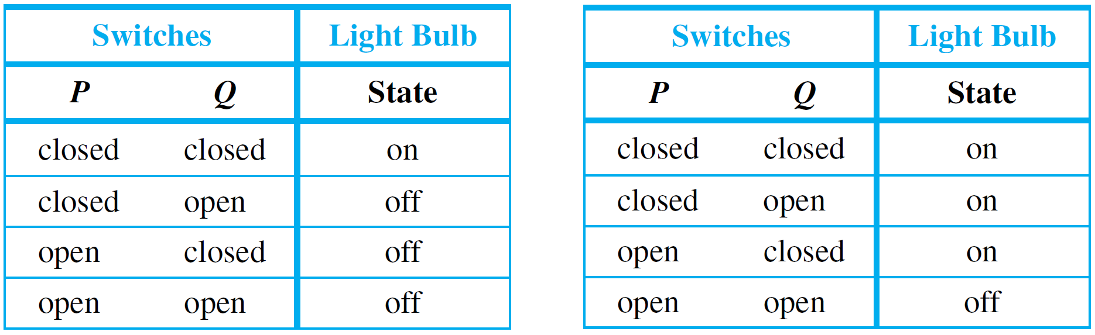
Application: Digital Logic Circuits
In the circuit of Figure 2.4.2(b) current flows and the light bulb turns on if, and only if, at least one of the switches P or Q is closed. The switches in this circuit are said to be in parallel. All possible behaviors of these circuits are described by Table 2.4.1.
(a) Switches in Series
(b) Switches in Parallel
Table 2.4.1

Slide 6
Application: Digital Logic Circuits
Observe that if the words closed and on are replaced by T and open and off are replaced by F, Table 2.4.1(a)
becomes the truth table for and and Table 2.4.1(b)
becomes the truth table for or.
Consequently, the switching circuit of Figure 2.4.2(a) is said to correspond to the logical expression P ∧ Q, and that
of Figure 2.4.2(b) is said to correspond to P ∨ Q.
(a) Switches “in series”
(b) Switches “in parallel”
Figure 2.4.2

Slide 7
Application: Digital Logic Circuits
More complicated circuits correspond to more complicated
logical expressions. This correspondence has been used
extensively in the design and study of circuits.
Electrical engineers continue to use the language of logic
when they refer to values of signals produced by an
electronic switch as being “true” or “false.” But they
generally use the symbols 1 and 0 rather than T and F to
denote these values.
The symbols 0 and 1 are called bits, short for binary digits.
This terminology was introduced in 1946 by the statistician John Tukey.

Slide 8
Black Boxes and Gates

Slide 9
Black Boxes and Gates
Combinations of signal bits (1’s and 0’s) can be
transformed into other combinations of signal bits (1’s and 0’s) by means of various circuits.
Because a variety of different technologies are used in circuit construction, computer engineers and digital system designers find it useful to think of certain basic circuits as black boxes.

Slide 10
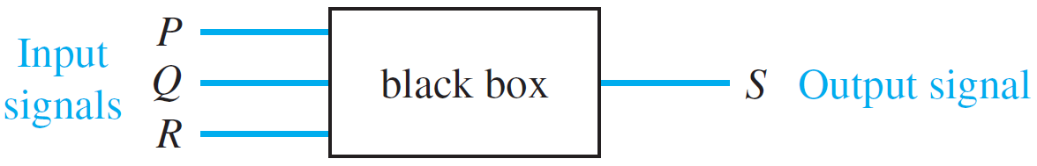
Black Boxes and Gates
The inside of a black box contains the detailed
implementation of the circuit and is often ignored while
attention is focused on the relation between the input and
the output signals.
The operation of a black box is completely specified by constructing an input/output table that lists all its
possible input signals together with their corresponding
output signals.

Slide 11
Black Boxes and Gates
For example, the black box picture has three input signals. Since each of these signals can take the value 1 or 0, there are eight possible combinations of input signals.

Slide 12
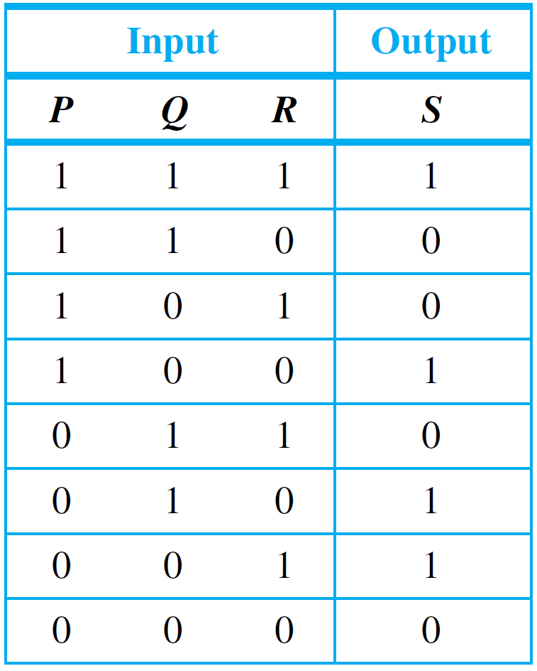
Black Boxes and Gates
One possible correspondence of input to output signals is as follows:
An Input/Output Table

Slide 13
Black Boxes and Gates
An efficient method for designing more complicated circuits is to build them by connecting less complicated black box
circuits. Three such circuits are known as NOT-, AND-, and OR-gates.
A NOT-gate (or inverter) is a circuit with one input signal and one output signal. If the input signal is 1, the
output signal is 0.
Conversely, if the input signal is 0, then the output signal
is 1. An AND-gate is a circuit with two input signals and one output signal. If both input signals are 1, then the output signal is 1.

Slide 14
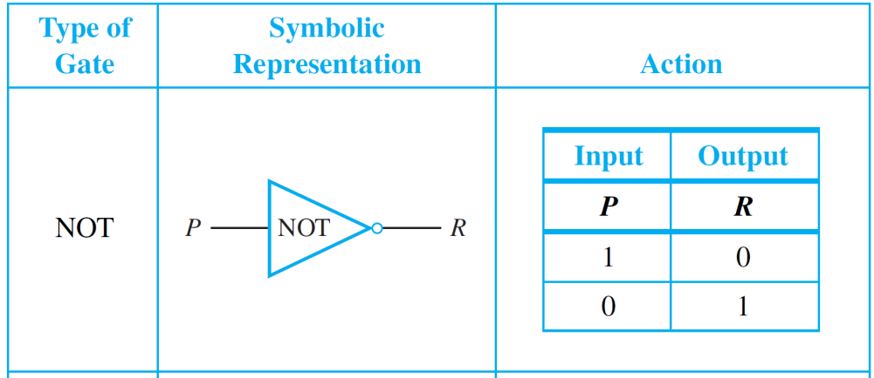
Black Boxes and Gates
Otherwise, the output signal is 0. An OR-gate also has two input signals and one output signal. If both input signals are 0, then the output signal is 0. Otherwise, the output signal is 1.
The actions of NOT-, AND-, and OR-gates are summarized
in Figure 2.4.3, where P and Q represent input signals and
R represents the output signal.
Figure 2.4.3

Slide 15
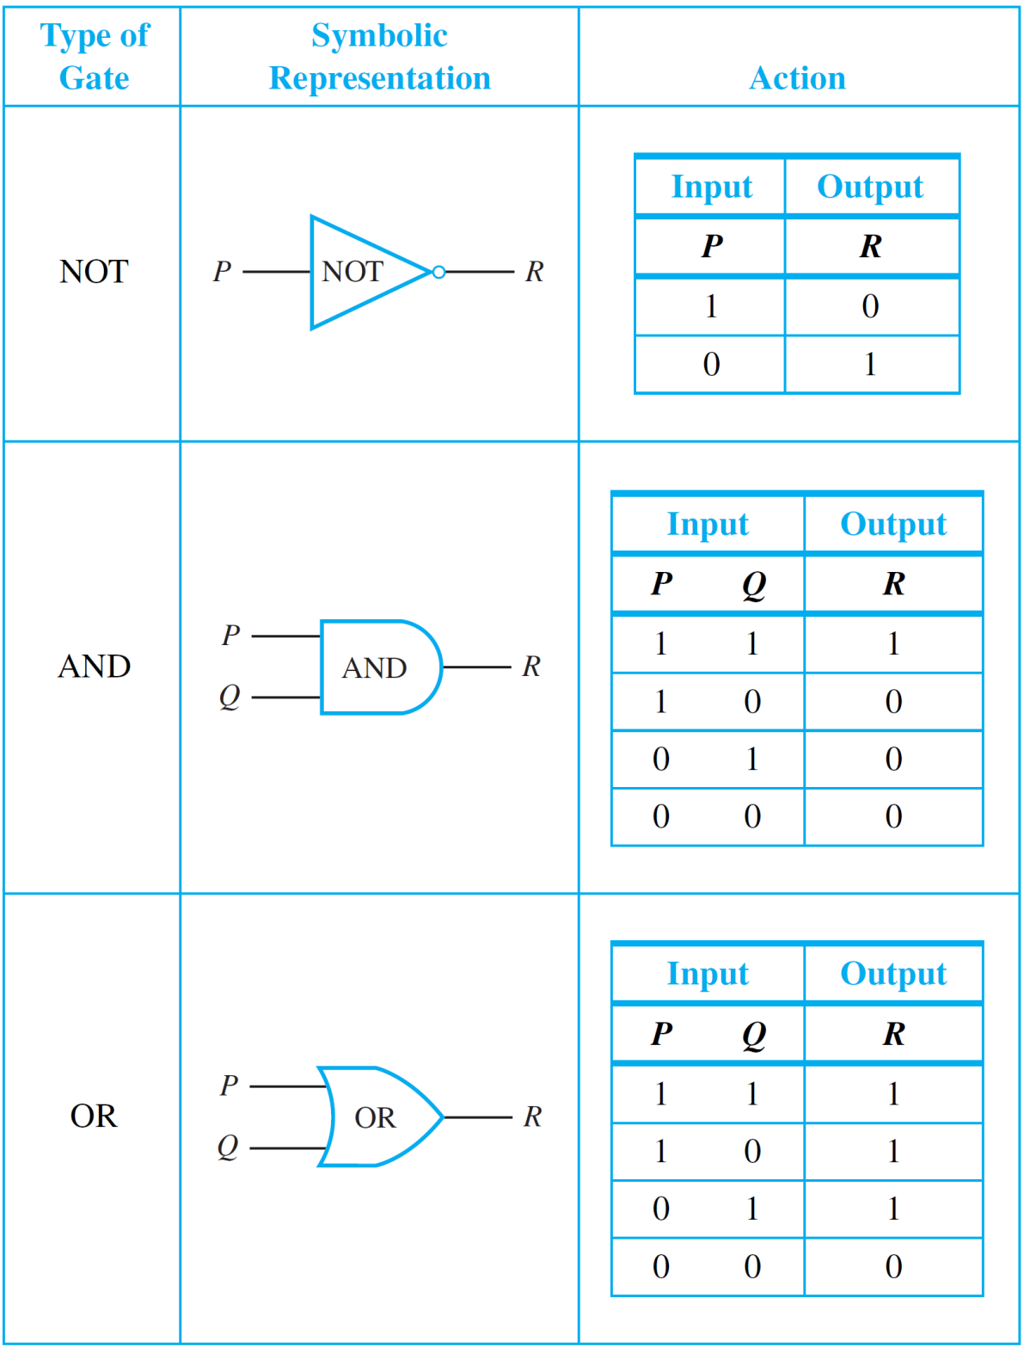
Black Boxes and Gates
Figure 2.4.3 (continued)

Slide 16
Black Boxes and Gates
It should be clear from Figure 2.4.3 that the actions of the NOT-, AND-, and OR-gates on signals correspond exactly to those of the logical connectives ∼, ∧, and ∨ on statements, if the symbol 1 is identified with T and the symbol 0 is identified with F.
Gates can be combined into circuits in a variety of ways. If
the rules shown on the next page are obeyed, the result is
a combinational circuit, one whose output at any time
is determined entirely by its input at that time without regard to previous inputs.

Slide 17
Rules for a Combinational Circuit

Slide 18
Rules for a Combinational Circuit
Never combine two input wires.
A single input wire can be split partway
and used as input for two separate gates.
An output wire can be used as input.
No output of a gate can eventually feed
back into that gate.
Rule (2.4.4) is violated in more complex circuits, called sequential circuits, whose output at any given time depends both on the input at that time and also on previous
inputs.
2.4.1
2.4.2
2.4.3
2.4.4

Slide 19
The Input/Output Table for a Circuit

Slide 20
The Input/Output Table for a Circuit
If you are given a set of input signals for a circuit, you can find its output by tracing through the circuit gate by gate.

Slide 21
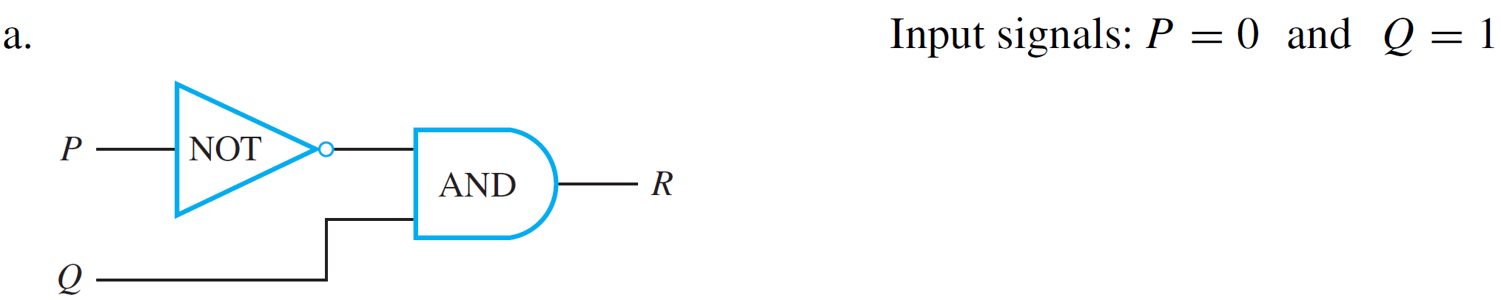
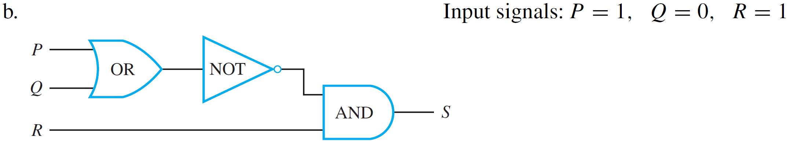
Example 1 – Determining Output for a Given Input
Indicate the output of the circuits shown below for the given input signals.
a.
b.

Slide 22
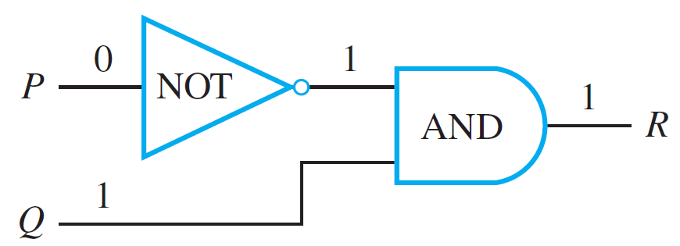
Example 1(a) – Solution
Move from left to right through the diagram, tracing the action of each gate on the input signals.
The NOT-gate changes P = 0 to a 1, so both inputs to the AND-gate are 1; hence the output R is 1.
This is illustrated by annotating the diagram as shown below.

Slide 23
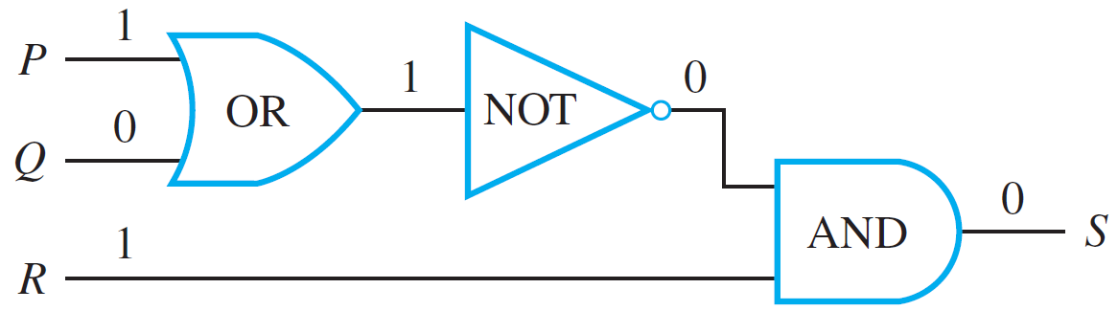
Example 1(b) – Solution
cont’d
The output of the OR-gate is 1 since one of the input
signals, P, is 1. The NOT-gate changes this 1 into a 0, so
the two inputs to the AND-gate are 0 and R = 1.
Hence the output S is 0. The trace is shown below.

Slide 24
The Boolean Expression
Corresponding to a Circuit

Slide 25
The Boolean Expression Corresponding to a Circuit
In logic, variables such as p, q and r represent statements,
and a statement can have one of only two truth values:
T(true) or F(false).
A statement form is an expression, such as p ∧ (∼q ∨ r), composed of statement variables and logical connectives.
As noted earlier, one of the founders of symbolic logic was the English mathematician George Boole. In his honor, any variable, such as a statement variable or an input signal, that can take one of only two values is called a Boolean variable. An expression composed of Boolean variables and the connectives ∼, ∧, and ∨ is called a Boolean expression.

Slide 26
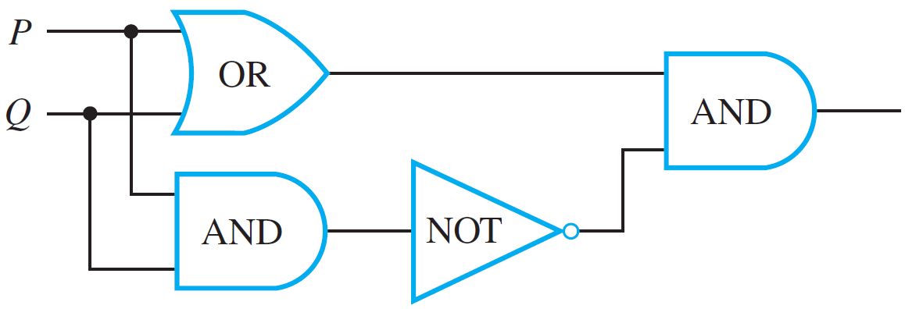
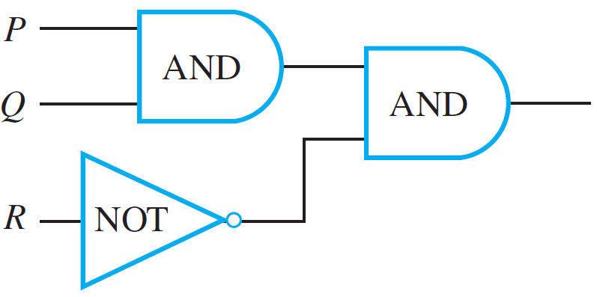
Example 3 – Finding a Boolean Expression for a Circuit
Find the Boolean expressions that correspond to the circuits shown below. A dot indicates a soldering of two
wires; wires that cross without a dot are assumed not to touch.
(a)
(b)

Slide 27
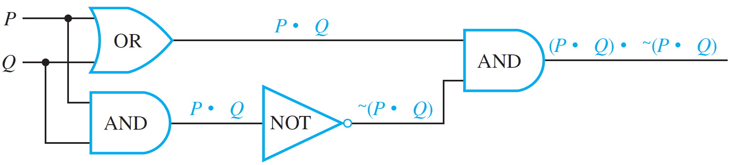
Example 3(a) – Solution
Trace through the circuit from left to right, indicating the output of each gate symbolically, as shown below.
The final expression obtained, (P ∨ Q) ∧ ∼(P ∧ Q), is the expression for exclusive or: P or Q but not both.

Slide 28
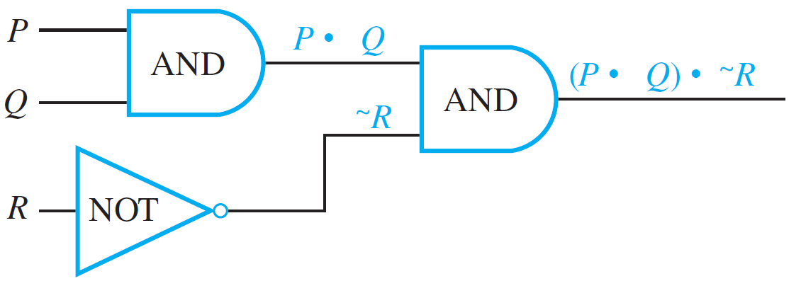
Example 3(b) – Solution
cont’d
The Boolean expression corresponding to the circuit is
(P ∧ Q) ∧ ∼R, as shown below.

Slide 29
The Boolean Expression Corresponding to a Circuit
Observe that the output of the circuit shown in
Example 3(b) is 1 for exactly one combination of inputs
(P = 1, Q = 1, and R = 0) and is 0 for all other combinations of inputs.

Slide 30
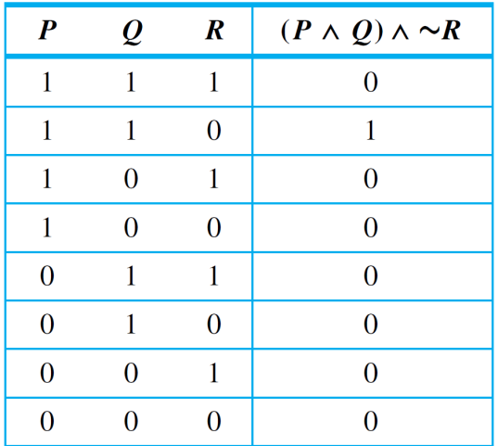
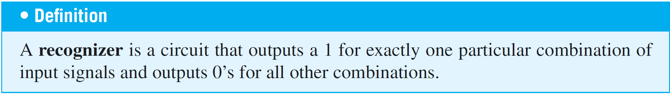
The Boolean Expression Corresponding to a Circuit
For this reason, the circuit can be said to “recognize” one particular combination of inputs. The output column of the input/output table has a 1 in exactly one row and 0’s in all other rows.
Input/Output Table for a Recognizer

Slide 31
The Circuit Corresponding to
a Boolean Expression

Slide 32
Example 4 – Constructing Circuits for Boolean Expressions
Construct circuits for the following Boolean expressions.
a. (∼P ∧ Q) ∨ ∼Q b. ((P ∧ Q) ∧ (R ∧ S)) ∧ T
Solution:
a. Write the input variables in a column on the left side of the diagram. Then go from the right side of the diagram to the left, working from the outermost part of the
expression to the innermost part.
Since the last operation executed when evaluating
(∼P ∧ Q) ∨ ∼Q is ∨, put an OR-gate at the extreme right of the diagram.

Slide 33
Example 4 – Solution
cont’d
One input to this gate is ∼P ∧ Q, so draw an AND-gate to the left of the OR-gate and show its output coming into the OR-gate.
Since one input to the AND-gate is ∼P, draw a line from P to a NOT-gate and from there to the AND-gate. Since the other input to the AND-gate is Q, draw a line from Q directly to the AND-gate.

Slide 34
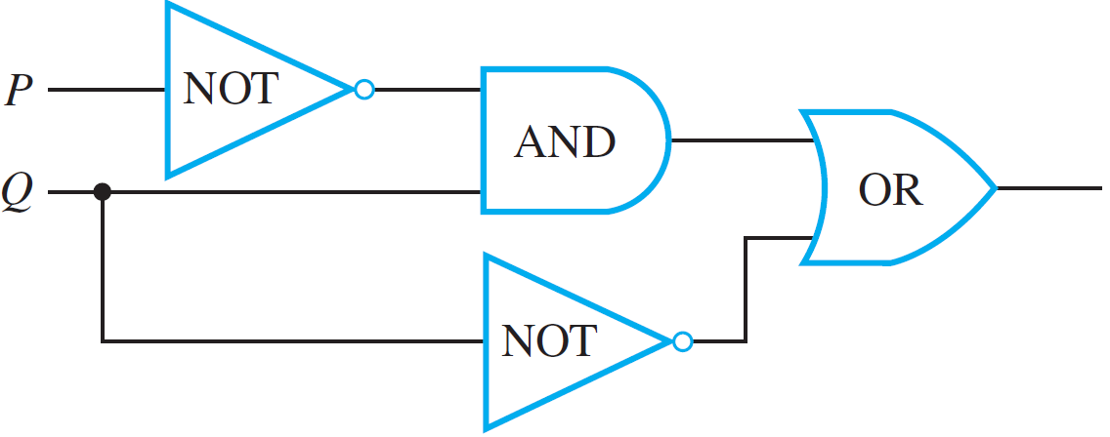
Example 4 – Solution
cont’d
The other input to the OR-gate is ∼Q, so draw a line from Q to a NOT-gate and from the NOT-gate to the OR-gate. The circuit you obtain is shown below.

Slide 35
Example 4 – Solution
cont’d
b. To start constructing this circuit, put one AND-gate at the extreme right for the ∧ between ((P ∧ Q) ∧ (R ∧ S)) and T.
To the left of that put the AND-gate corresponding to the ∧ between P ∧ Q and R ∧ S.
To the left of that put the AND-gates corresponding to the ∧’s between P and Q and between R and S.

Slide 36
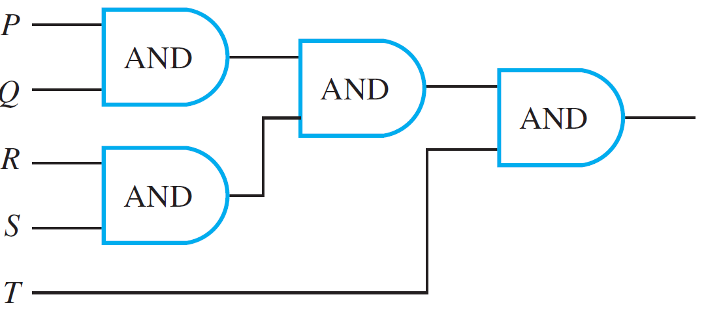
Example 4 – Solution
cont’d
The circuit is shown in Figure 2.4.4.
Figure 2.4.4

Slide 37
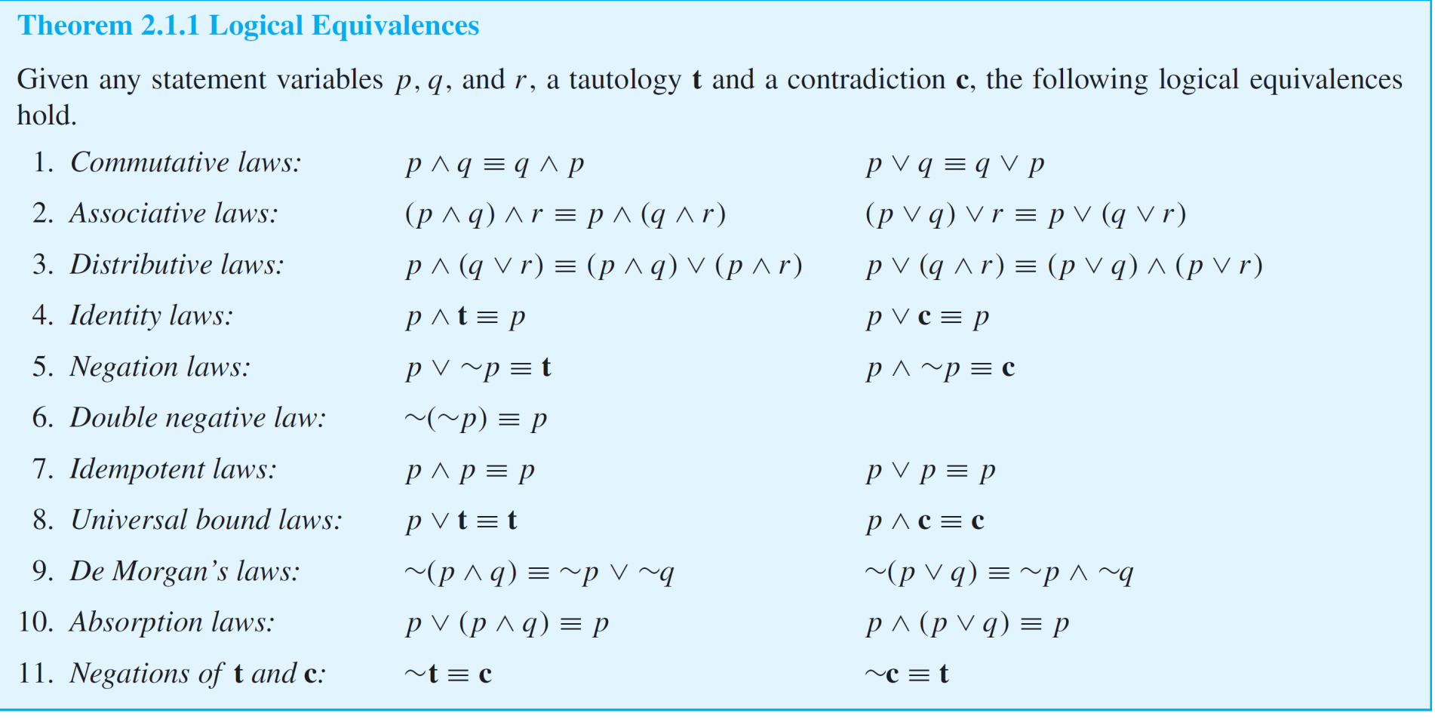
The Circuit Corresponding to a Boolean Expression
It follows from Theorem 2.1.1 that all the ways of adding parentheses to P ∧ Q ∧ R ∧ S ∧ T are logically equivalent.

Slide 38
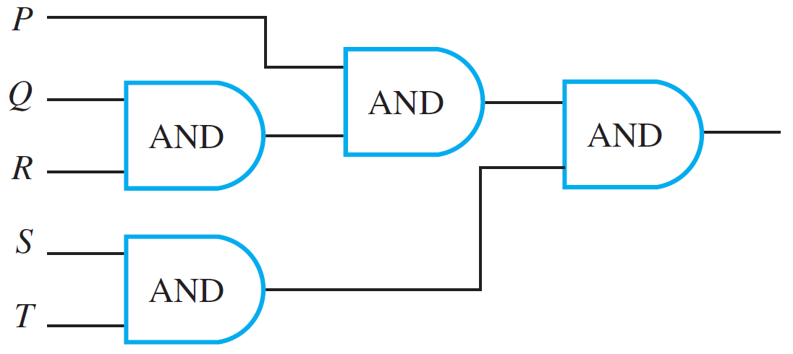

The Circuit Corresponding to a Boolean Expression
Thus, for example,
((P ∧ Q) ∧ (R ∧ S)) ∧ T ≡ (P ∧ (Q ∧ R)) ∧ (S ∧ T).
It also follows that the circuit in Figure 2.4.5, which corresponds to (P ∧ (Q ∧ R)) ∧ (S ∧ T), has the same input/output table as the circuit in Figure 2.4.4, which corresponds to ((P ∧ Q) ∧ (R ∧ S)) ∧ T.
Figure 2.4.5
Figure 2.4.4

Slide 39
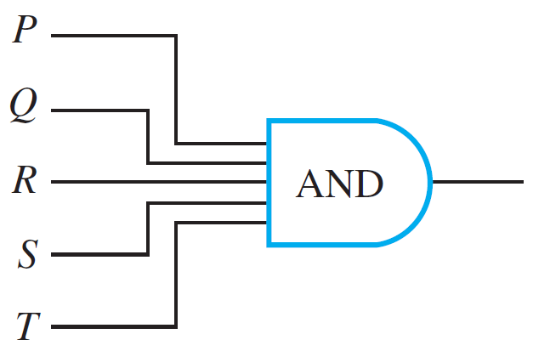
The Circuit Corresponding to a Boolean Expression
Each of the circuits in Figures 2.4.4 and 2.4.5 is, therefore, an implementation of the expression P ∧ Q ∧ R ∧ S ∧ T.
Such a circuit is called a multiple-input AND-gate and is
represented by the diagram shown in Figure 2.4.6.
Multiple-input OR-gates are constructed similarly.
Figure 2.4.6

Slide 40
Finding a Circuit That Corresponds
to a Given Input/Output Table

Slide 41
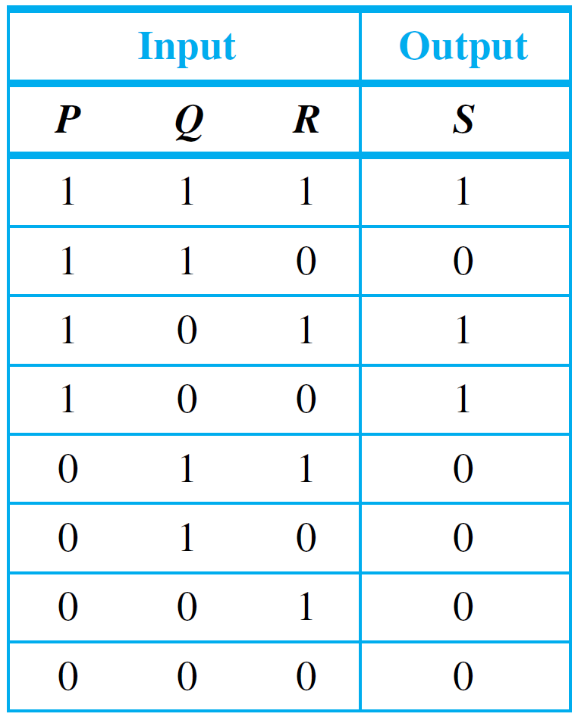
Example 5 – Designing a Circuit for a Given Input/Output Table
Design a circuit for the following input/output table:

Slide 42
Example 5 – Solution
First construct a Boolean expression with this table as its truth table. To do this, identify each row for which the output is 1—in this case, the first, third, and fourth rows.
For each such row, construct an and expression that
produces a 1 (or true) for the exact combination of input
values for that row and a 0 (or false) for all other
combinations of input values.
For example, the expression for the first row is P ∧ Q ∧ R because P ∧ Q ∧ R is 1 if P = 1 and Q = 1 and R = 1, and it is 0 for all other values of P, Q, and R.

Slide 43
Example 5 – Solution
cont’d
The expression for the third row is P ∧ ∼Q ∧ R because
P ∧ ∼Q ∧ R is 1 if P = 1 and Q = 0 and R = 1, and it is 0 for all other values of P, Q, and R. Similarly, the expression for the fourth row is P ∧ ∼Q ∧ ∼R.
Now any Boolean expression with the given table as its truth table has the value 1 in case P ∧ Q ∧ R = 1, or in case P ∧ ∼Q ∧ R = 1, or in case P ∧ ∼Q ∧ ∼R = 1, and in no other cases.
It follows that a Boolean expression with the given truth table is
(P ∧ Q ∧ R) ∨ (P ∧ ∼Q ∧ R) ∨ (P ∧ ∼Q ∧ ∼R).
2.4.5

Slide 44
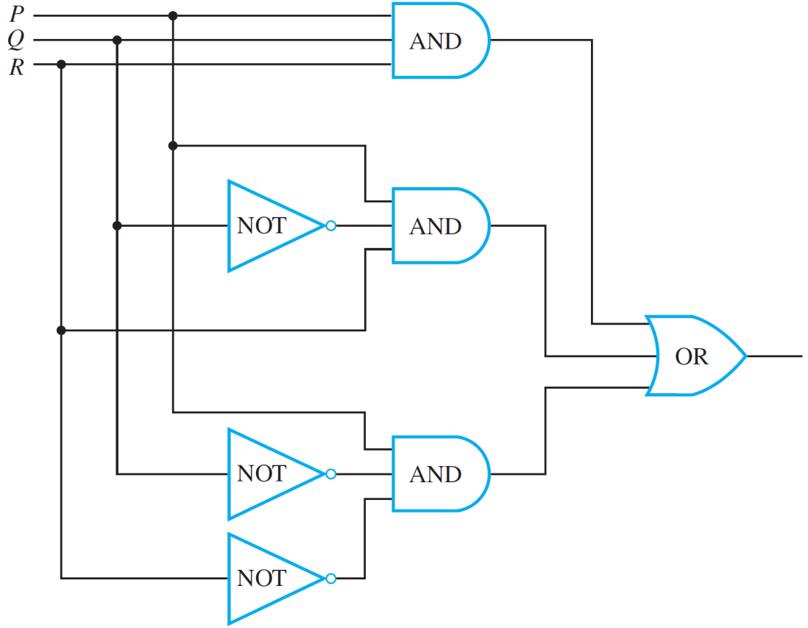
Example 5 – Solution
cont’d
The circuit corresponding to this expression has the diagram shown in Figure 2.4.7.
Figure 2.4.7

Slide 45
Example 5 – Solution
cont’d
Observe that expression
(P ∧ Q ∧ R) ∨ (P ∧ ∼Q ∧ R) ∨ (P ∧ ∼Q ∧ ∼R).
is a disjunction of terms that are themselves conjunctions in which one of P or ∼P, one of Q or ∼Q, and one of R or ∼R all appear.
Such expressions are said to be in disjunctive normal form or sum-of-products form.
2.4.5

Slide 46
Simplifying Combinational Circuits

Slide 47
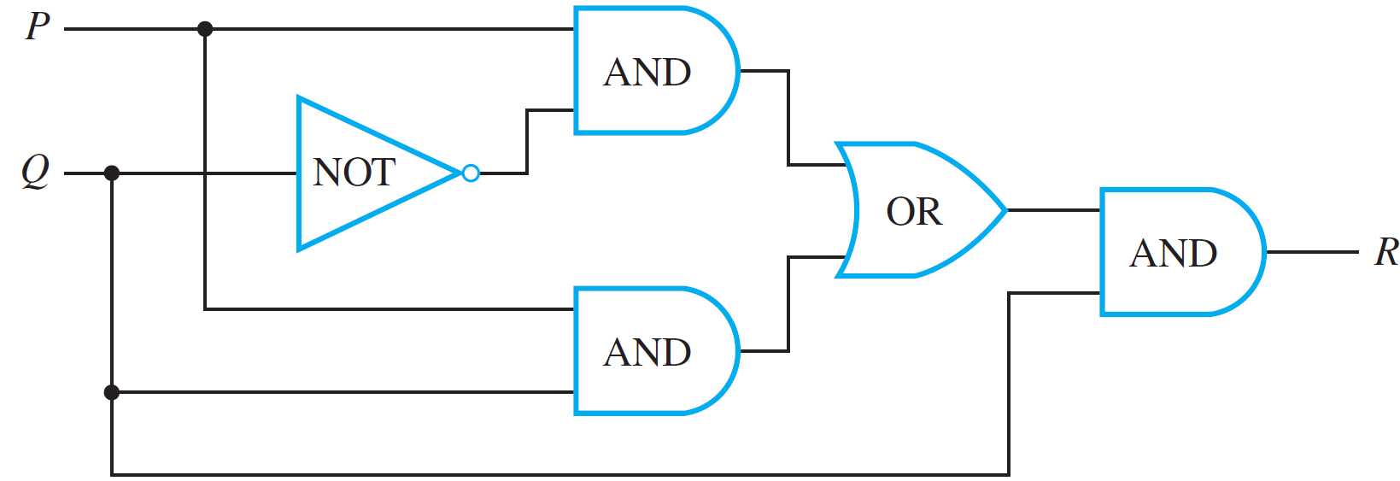
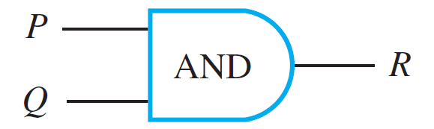
Simplifying Combinational Circuits
Consider the two combinational circuits shown in
Figure 2.4.8.
(a)
(b)
Figure 2.4.8

Slide 48
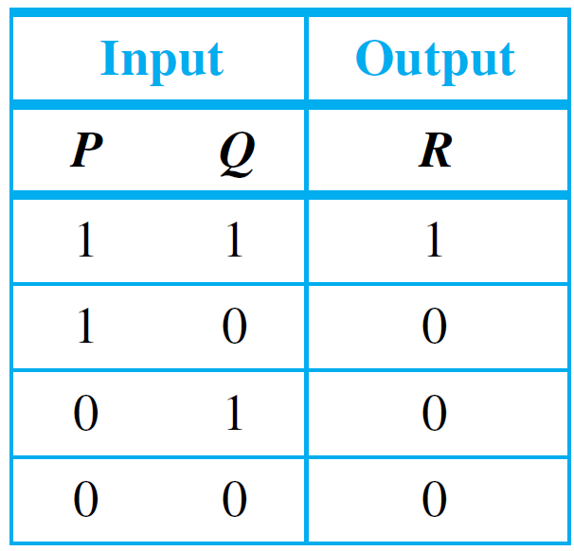
Simplifying Combinational Circuits
If you trace through circuit (a), you will find that its input/output table is
which is the same as the input/output table for circuit (b). Thus these two circuits do the same job in the sense that they transform the same combinations of input signals into the same output signals.

Slide 49
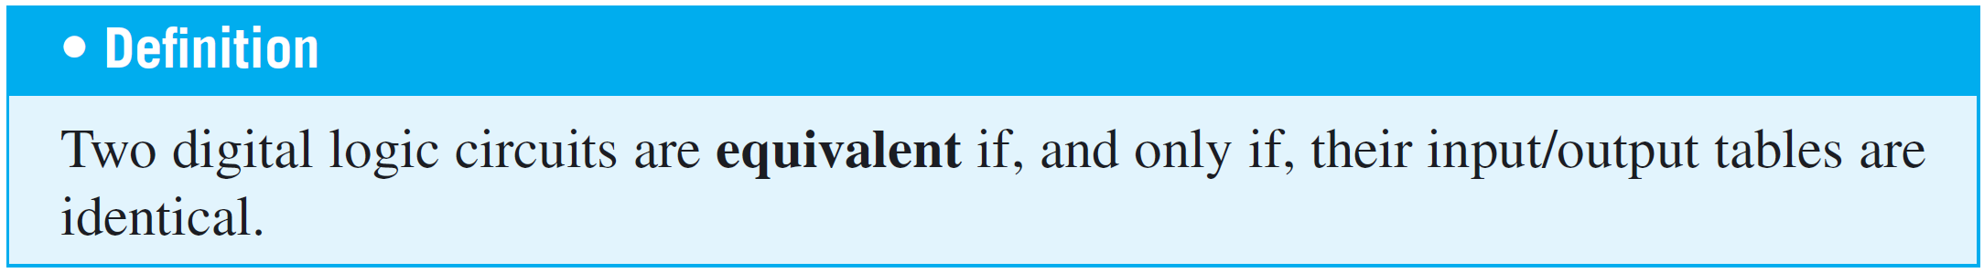
Simplifying Combinational Circuits
Yet circuit (b) is simpler than circuit (a) in that it contains many fewer logic gates. Thus, as part of an integrated circuit, it would take less space and require less power.

Slide 50
Example 6 – Showing That Two Circuits Are Equivalent
Find the Boolean expressions for each circuit in
Figure 2.4.8. Use Theorem 2.1.1 to show that these expressions are logically equivalent when regarded as statement forms.
(a)
(b)
Figure 2.4.8

Slide 51
Example 6 – Showing That Two Circuits Are Equivalent
cont’d

Slide 52

Example 6 – Solution
The Boolean expressions that correspond to circuits (a) and (b) are ((P ∧ ∼Q) ∨ (P ∧ Q)) ∧ Q and P ∧ Q, respectively.
By Theorem 2.1.1,

Slide 53
Example 6 – Solution
cont’d
It follows that the truth tables for ((P ∧ ∼Q) ∨ (P ∧ Q)) ∧ Q and P ∧ Q are the same.
Hence the input/output tables for the circuits corresponding to these expressions are also the same, and so the circuits are equivalent.

Slide 54
NAND and NOR Gates

Slide 55
NAND and NOR Gates
Another way to simplify a circuit is to find an equivalent circuit that uses the least number of different kinds of logic
gates.
Two gates not previously introduced are particularly
useful for this: NAND-gates and NOR-gates. A NAND-gate
is a single gate that acts like an AND-gate followed by a NOT-gate. A NOR-gate acts like an OR-gate followed by a
NOT-gate.

Slide 56
NAND and NOR Gates
Thus the output signal of a NAND-gate is 0 when, and only when, both input signals are 1, and the output signal for a NOR-gate is 1 when, and only when, both input signals
are 0.
The logical symbols corresponding to these gates are | (for NAND) and ↓ (for NOR), where | is called a Sheffer stroke (after H. M. Sheffer, 1882–1964) and ↓ is called a Peirce arrow (after C. S. Peirce, 1839–1914). Thus

Slide 57
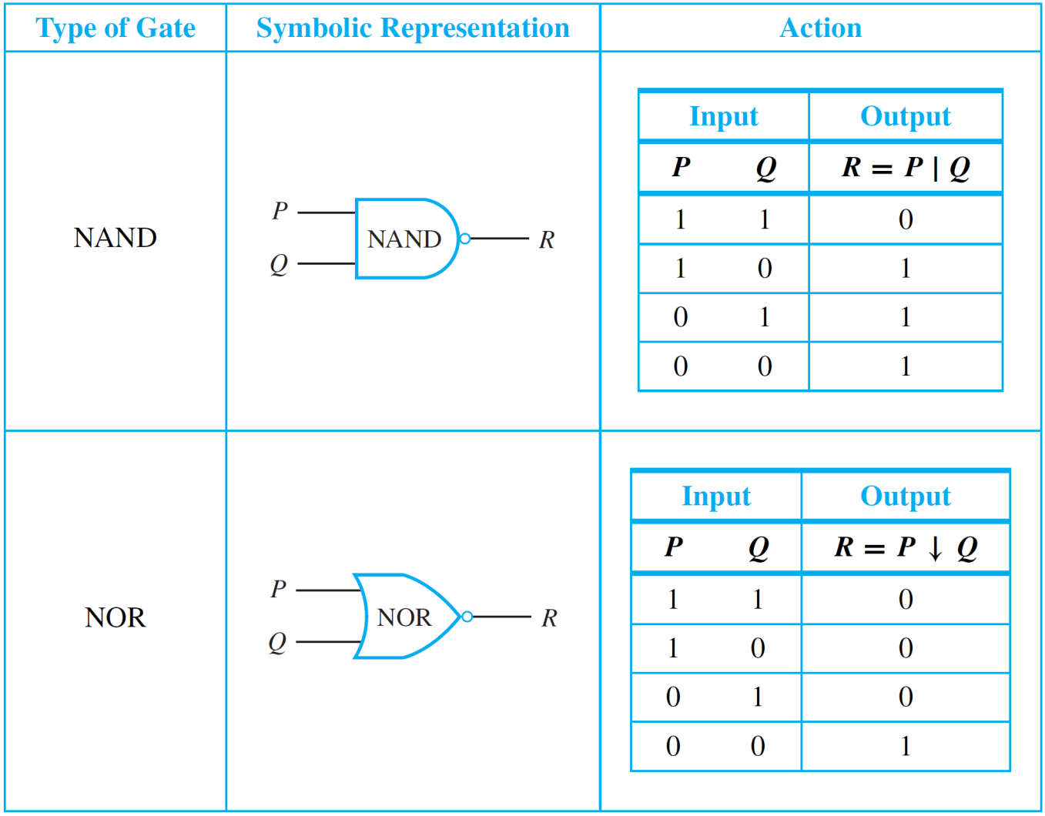
NAND and NOR Gates
The table below summarizes the actions of NAND and NOR gates.

Slide 58
NAND and NOR Gates
It can be shown that any Boolean expression is equivalent to one written entirely with Sheffer strokes or entirely with Peirce arrows.
Thus any digital logic circuit is equivalent to one that uses only NAND-gates or only NOR-gates.

Slide 59
Example 7 – Rewriting Expressions Using the Sheffer Stroke
Use Theorem 2.1.1 and the definition of Sheffer stroke to show that
a. and b.
Solution:
a.
b.

Slide 60
Example 7 – Solution
cont’d

